Slide 1
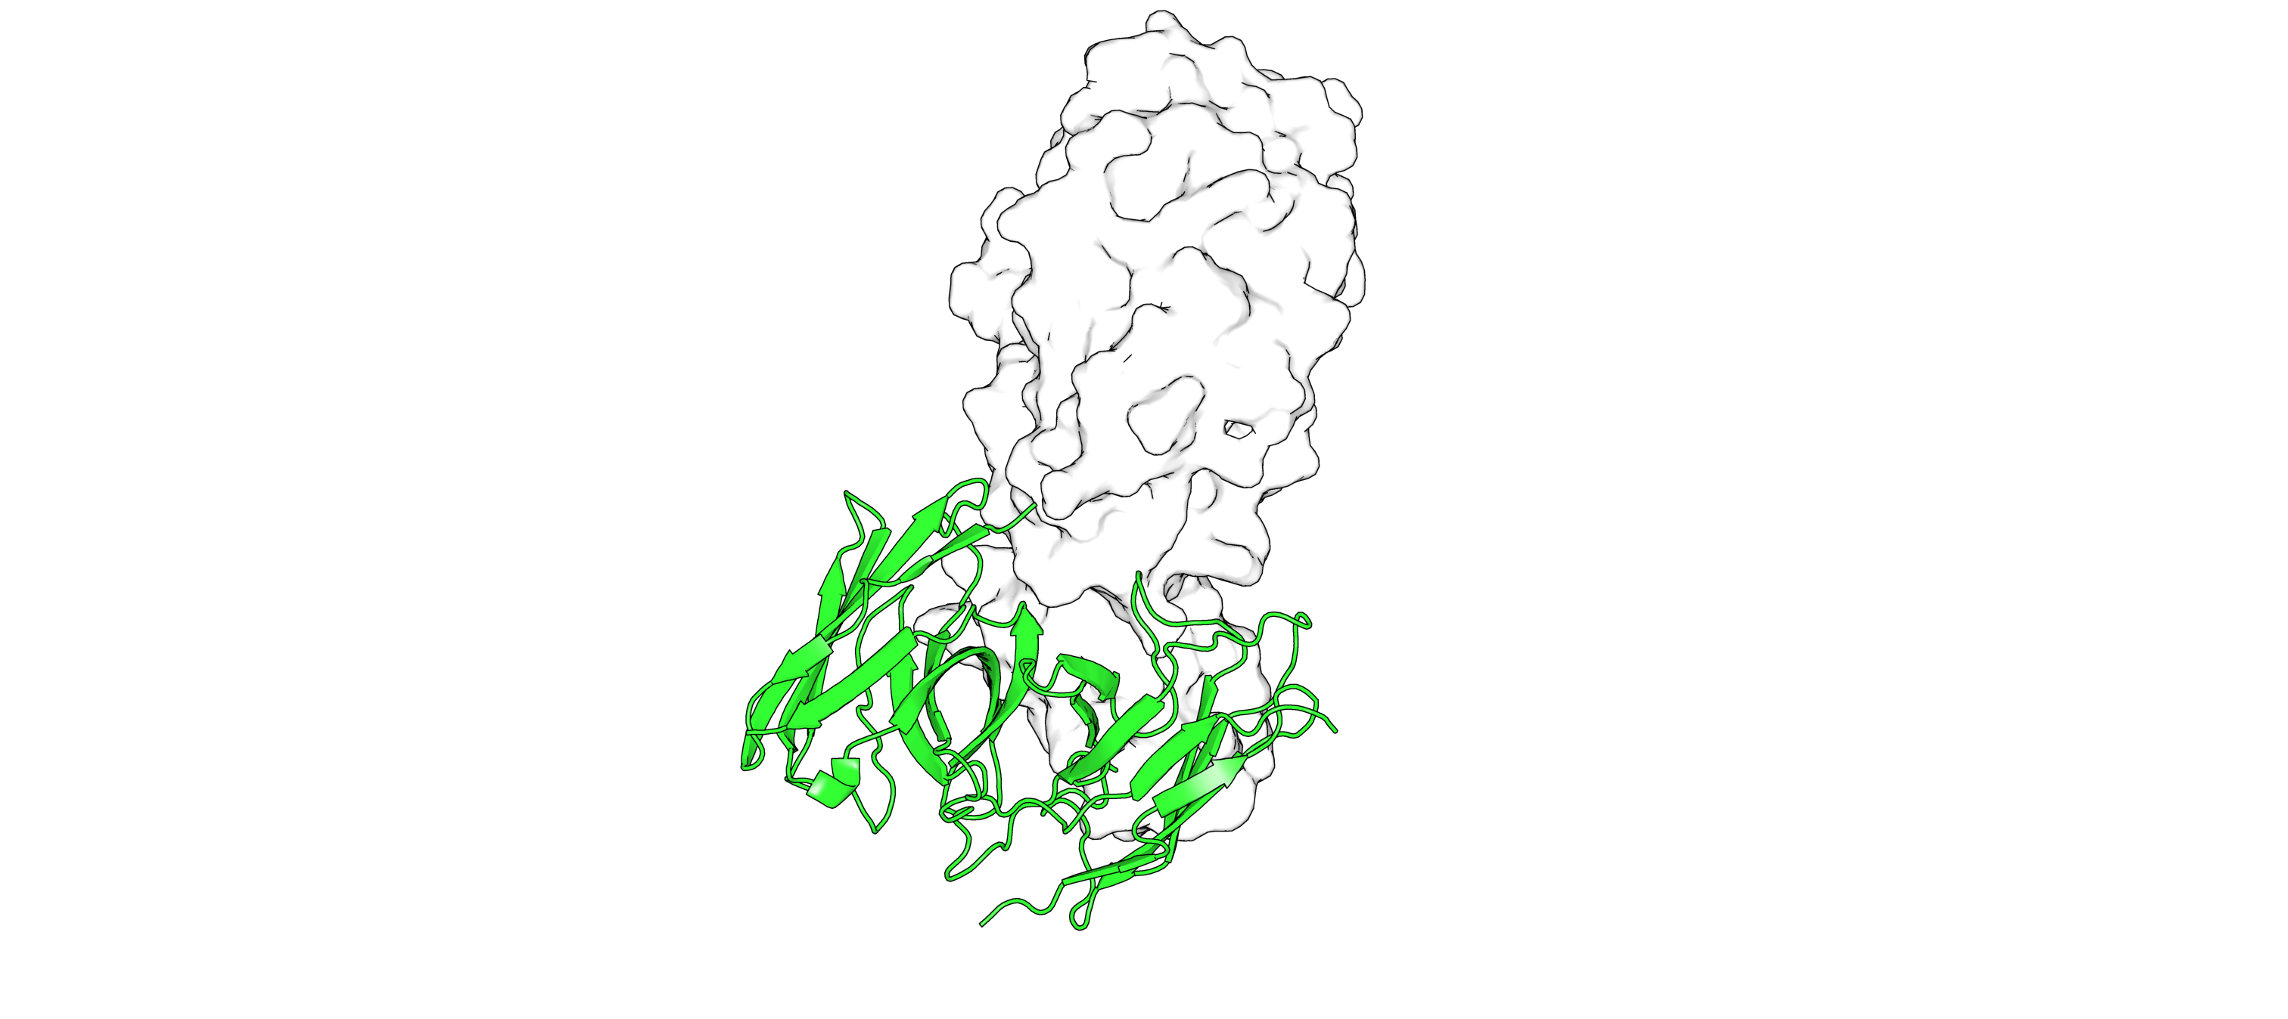
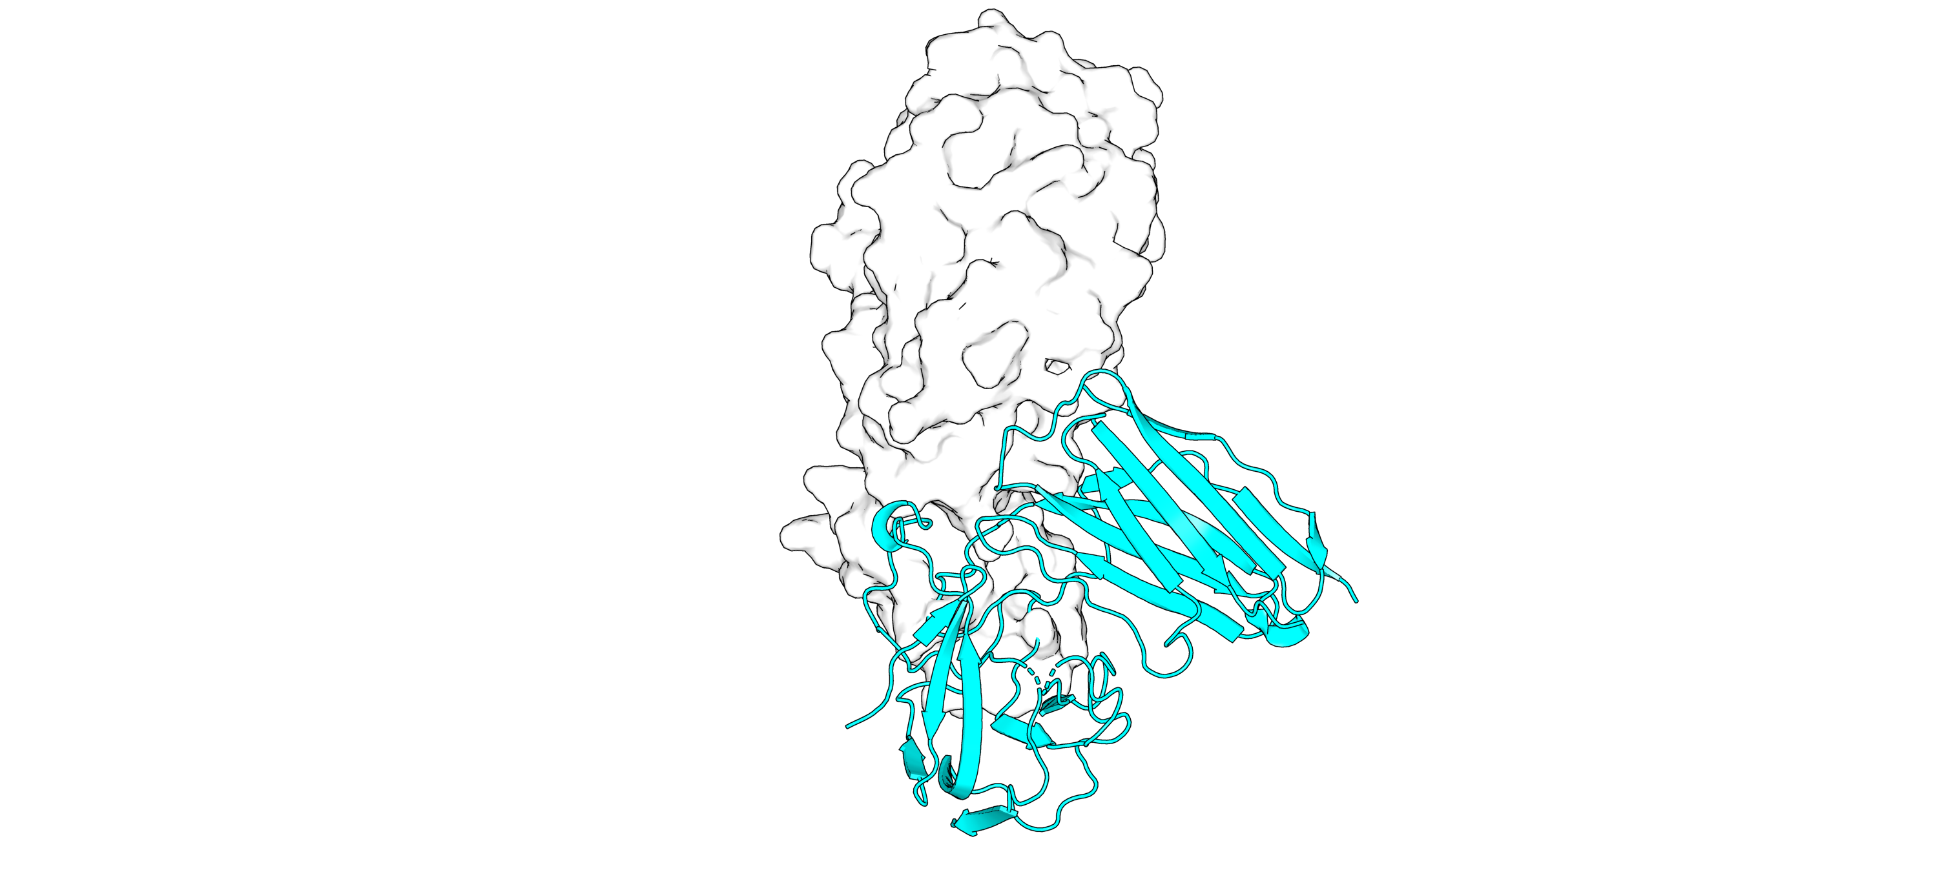
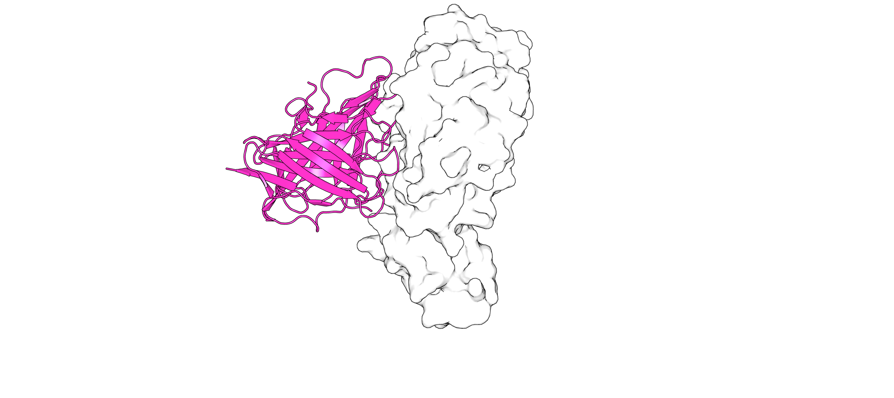
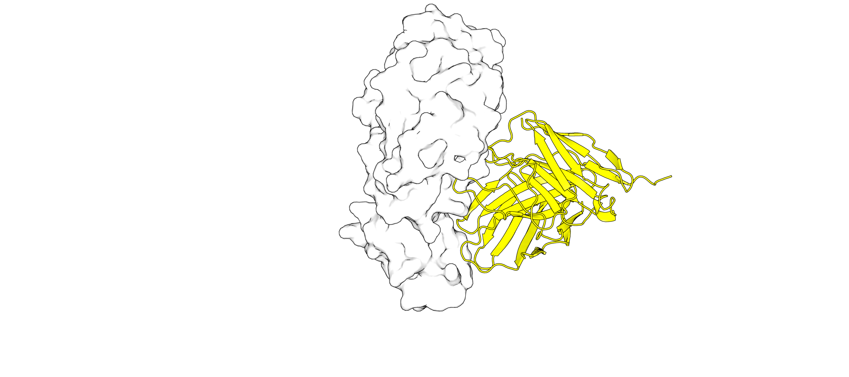
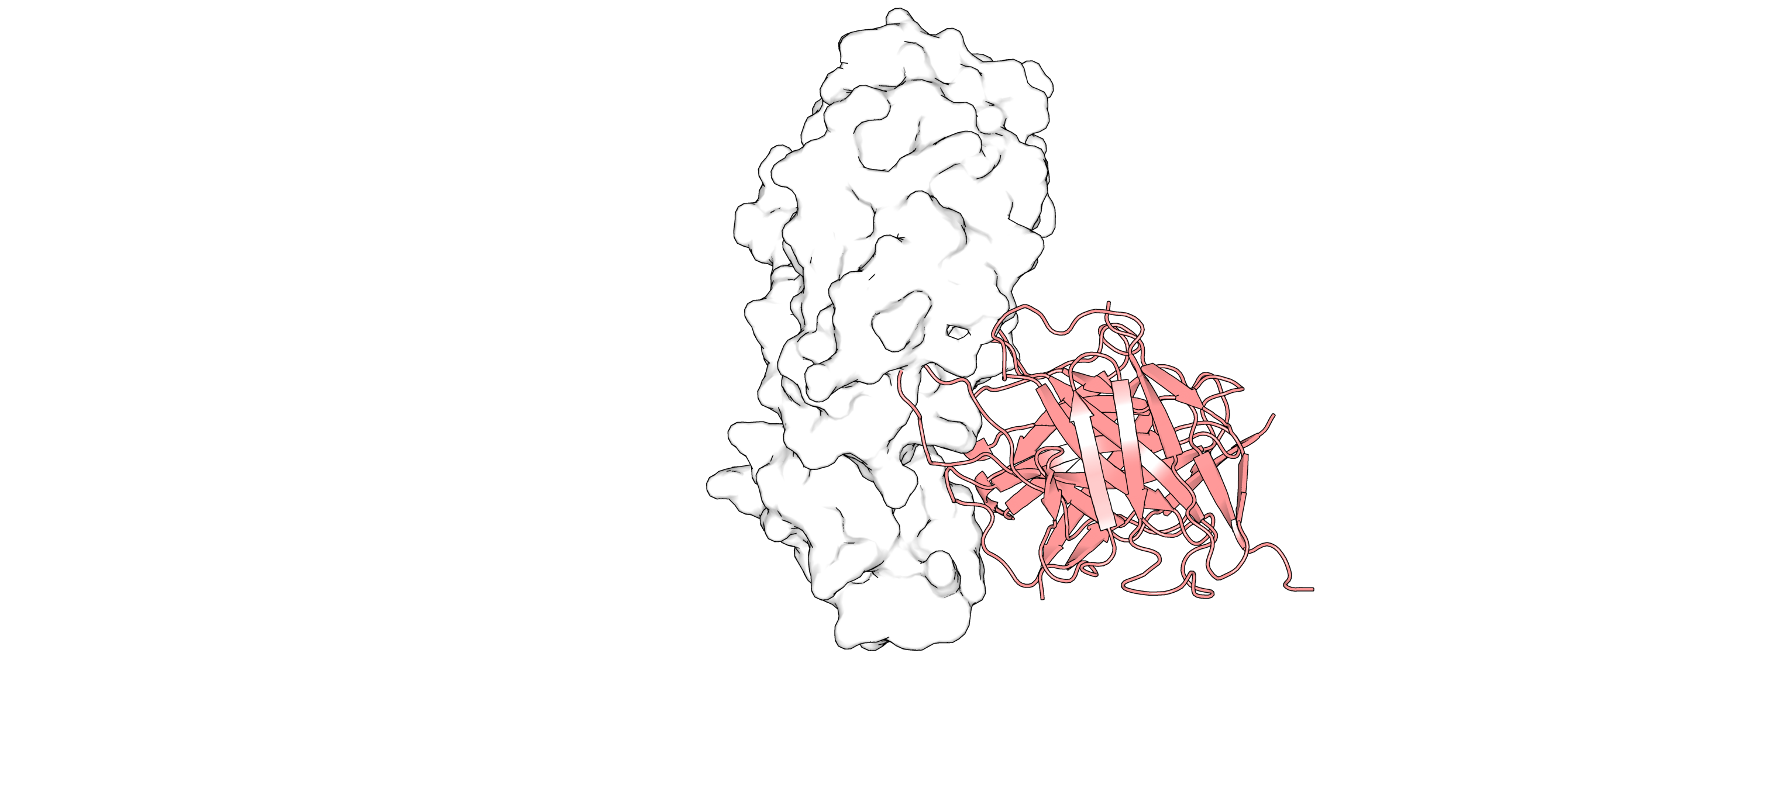
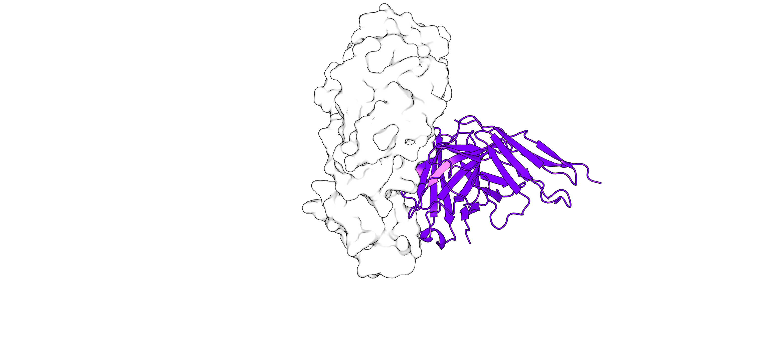
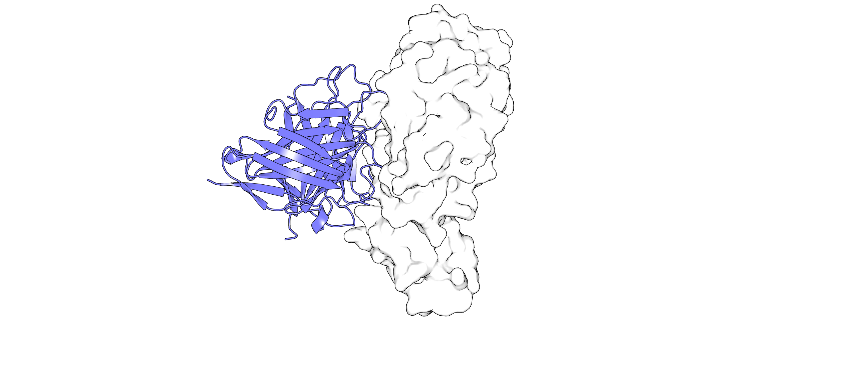
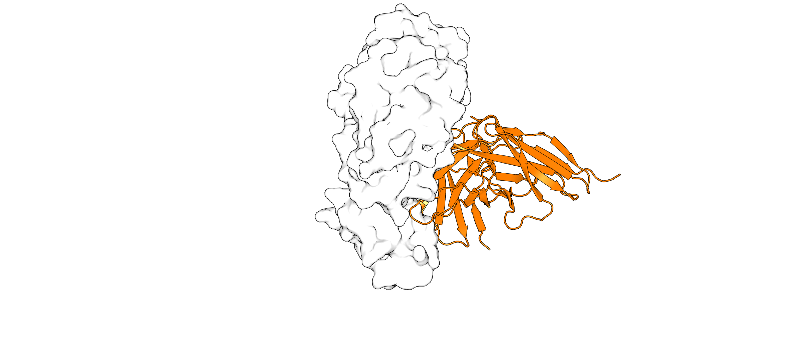
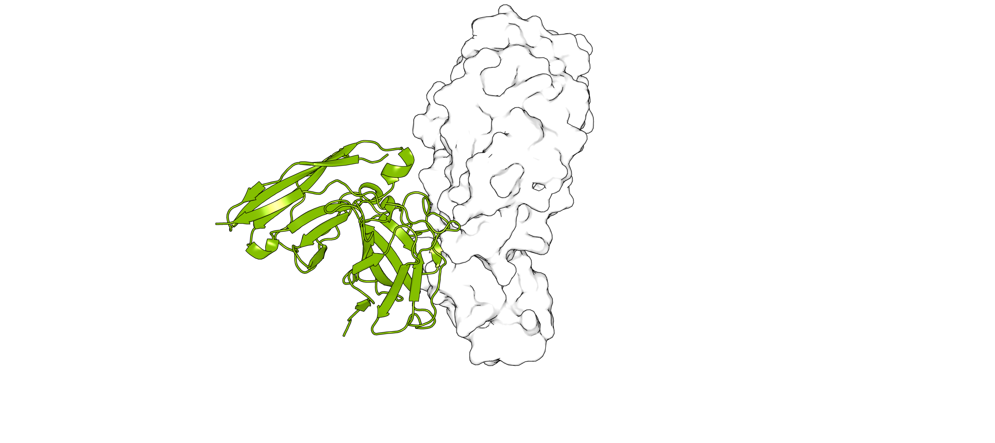
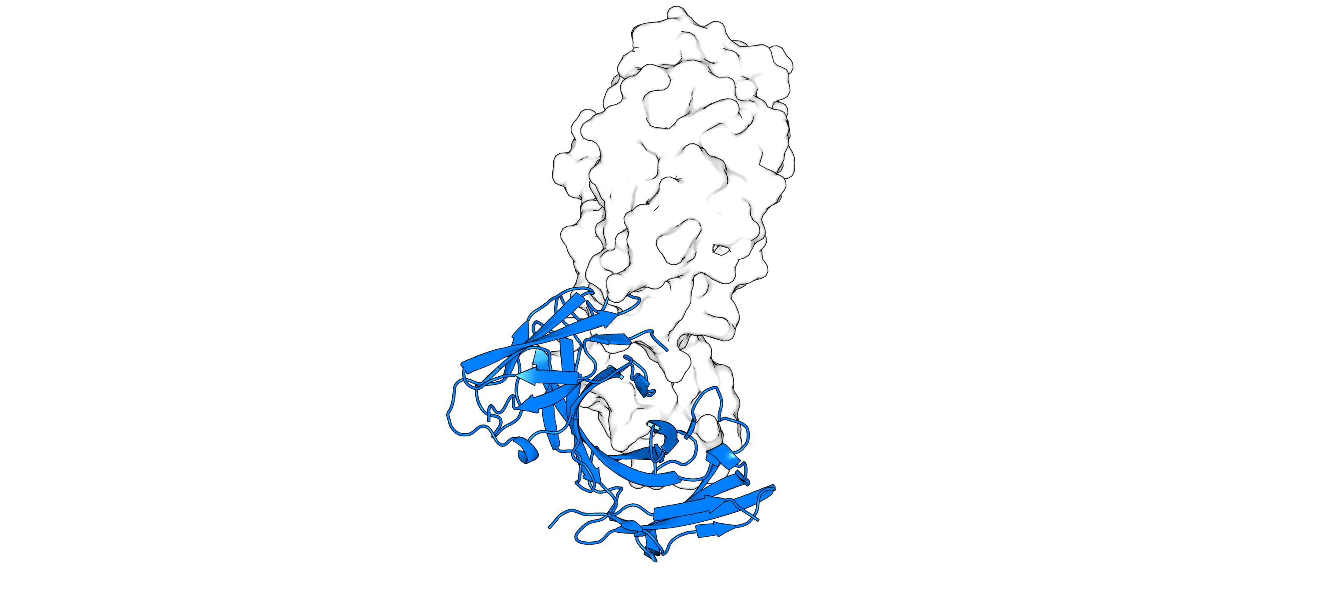
1) gilded-stud | 2) intentive-amarone
4) free-hearth | 4) concave-glove
5) recursive-basin | 6) brilliant-charge
7) soft-spook | 8) bitter-folder
9) approximate-entrepreneur | 10) partial-lagoon

Slide 2
1) gilded-stud | 2) intentive-amarone
4) free-hearth | 4) concave-glove
5) recursive-basin | 6) brilliant-charge
7) soft-spook | 8) bitter-folder
9) approximate-entrepreneur | 10) partial-lagoon

